Slide 1

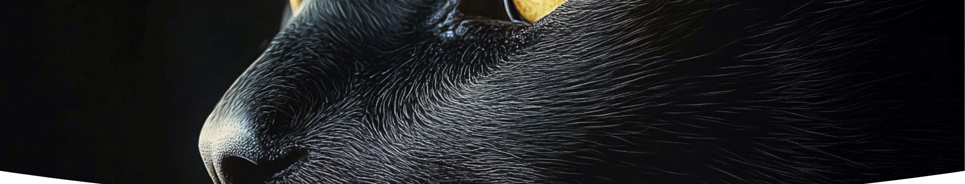

Dog vs Cat CNN Classifier with PySwarm Optimization
Presented by : Mohamed Amir Ghanam
Supervised by: A.Prof.Ahmed Magdy
Dr.Iman Mostafa

Slide 2


CONTENTS
1. Project Overview
5. Results - Performance Comparison
2. Problem Statement
4. Methodology - PySwarm Optimization
3. Methodology - CNN Model
6. Conclusion

Slide 3
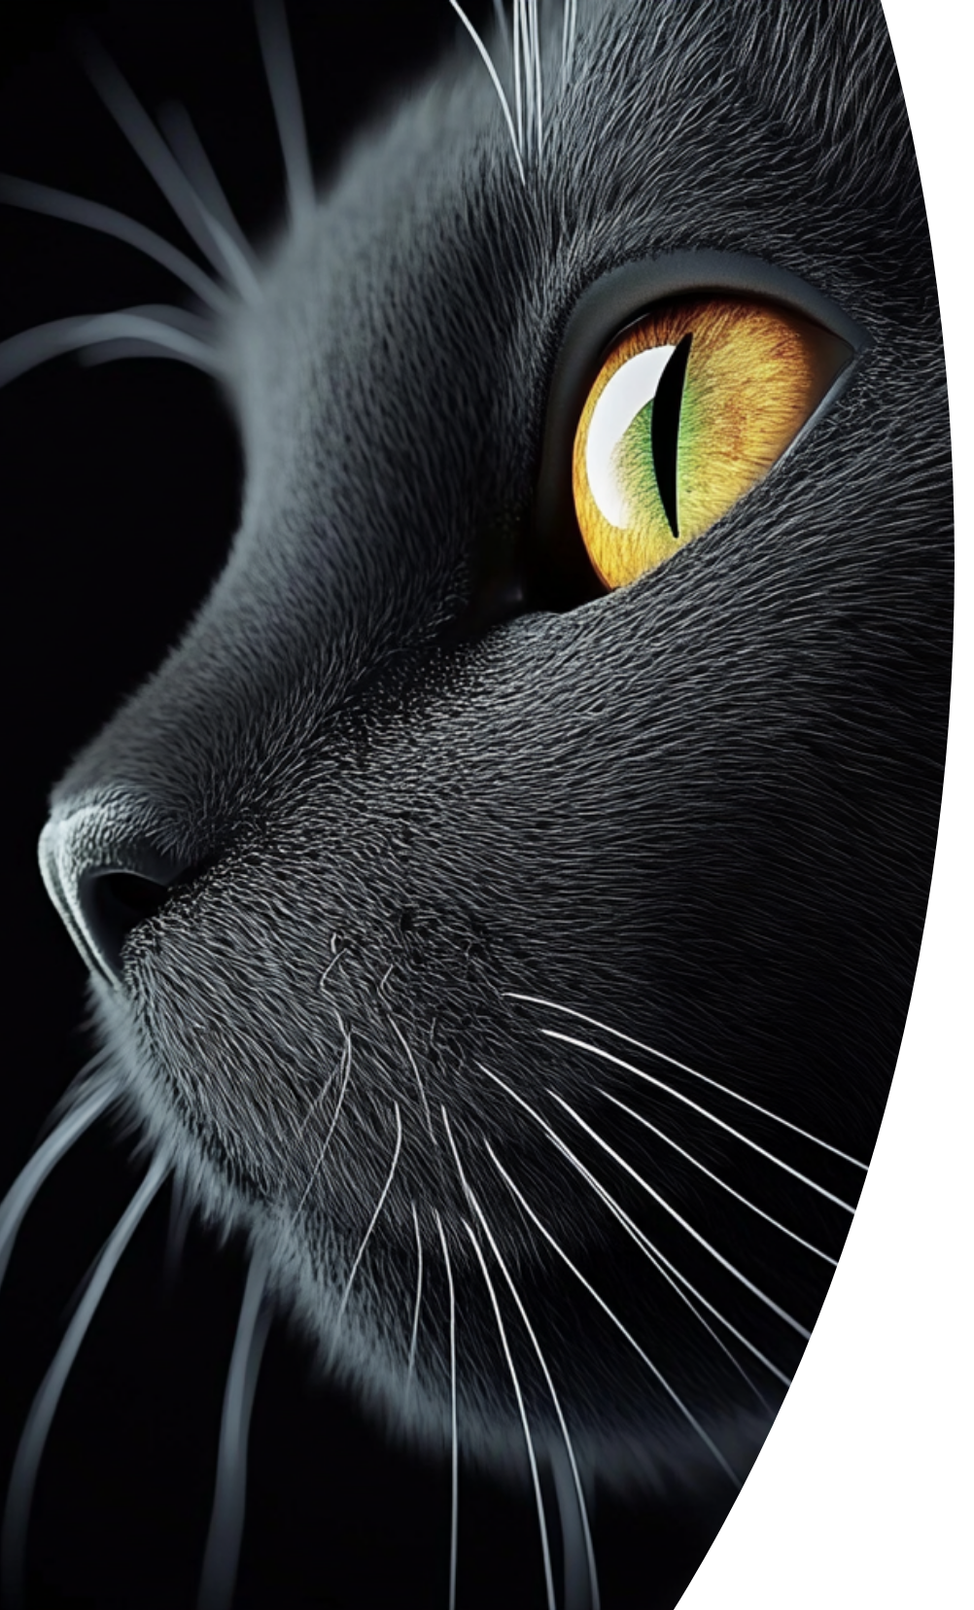
01 Project Overview
Objective
Develop a convolutional neural network (CNN) to classify dog and cat images, enhanced by PySwarm optimization for superior accuracy.

Slide 4


02
Problem Statement

Slide 5



Challenges
Manual hyperparameter tuning is time-consuming and often suboptimal
2
High variability in images (breeds, poses, lighting, backgrounds)
1
Risk mediocre models struggle with overfitting without proper regularization
3

Slide 6

Solution
Use Particle Swarm Optimization (PySwarm) to automatically tune hyperparameters for optimal CNN performance.

Slide 7

03
Methodology - CNN Model

Slide 8




Architecture
2
Layers: 4 convolutional blocks (Conv2D, ReLU, BatchNorm, MaxPooling), dropout for regularization, 3 fully connected layers
Input: 224x224x3 RGB images
1
Output: 2 classes (Dog or Cat)
3

Slide 9

Training
Adam optimizer, Cross Entropy Loss with label smoothing
Data augmentation: Random flips, rotations, color jitter
Features: Early stopping, learning rate scheduling, model checkpointing

Slide 10

04
Methodology - PySwarm Optimization

Slide 11

PySwarm Overview
Particle Swarm Optimization, a metaheuristic algorithm inspired by swarm behavior, for hyperparameter tuning.

Slide 12



Optimized Parameters
Number of convolutional layers: 3–10
Fully connected neurons: 32–256 (FC1), 16–128 (FC2), 8–64 (FC3)
Batch size: 8–64 (2^n pattern)
Learning rate: 0.0001–0.002 (0.001*n pattern)
Dropout rate: 0.1–0.7, Weight decay: 1e-5 to 1e-3

Slide 13

06
Results - Performance Comparison

Slide 14


Original CNN Model
1
Validation Accuracy: 84%
2
Architecture: Fixed 4 convolutional blocks, 3 FC layers
3
Limitations: Manual tuning, moderate generalization

Slide 15



PySwarm-Optimized CNN
Architecture: Dynamic layers (3–10), optimized hyperparameters
2
Validation Accuracy: 93.77% (+9.77% improvement)
1
3
Benefits: Higher accuracy, better generalization, automated tuning

Slide 16

Benefits
Intuitive, clean design with solid color backgrounds
Enables easy model testing and performance comparison

Slide 17
Summary
Enhanced to 93.77% accuracy using PySwarm optimization
2
Developed a CNN achieving 84% accuracy for dog/cat classification
1
3
Built an intuitive GUI for interactive testing and model comparison

Slide 18

Thank You

